Slide 1



Data Visualization Take Home Assignment 1
Company
data
M114020002 呂心慈

Slide 2


TABLE OF CONTENTS
1
2
3
Data
Question 1
4
Question 2
Question 3

Slide 3
Introduce Data
The variables of this data :
Company ( total have 14 companies)
Logo
Size
Business
Location
Established
Sales ( year 1 ~ year 5 )
Profit ( year 1 ~ year 5 )
Stock price

Slide 4
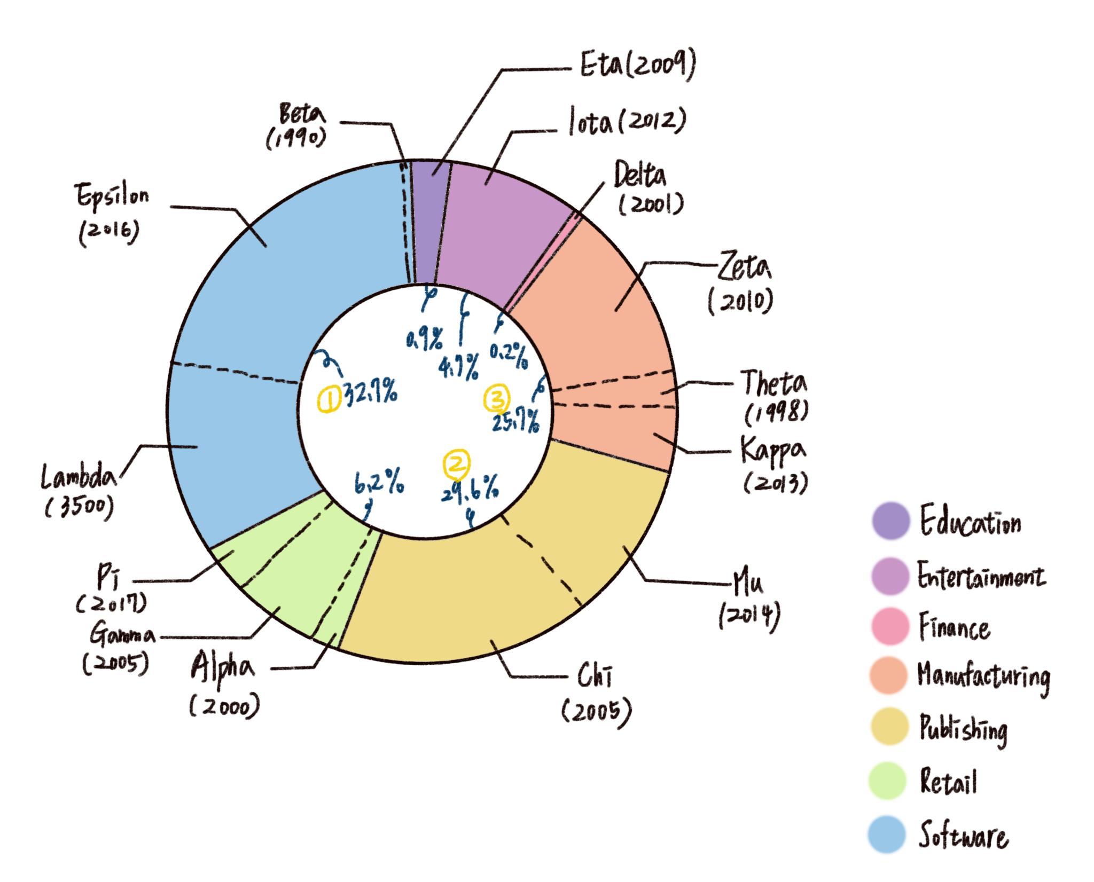
Question 1
Q : Which industries are dominant in this dataset and which ones are secondary?
Draw:

Slide 5
Question 1
Pros
From the image, it is immediately apparent that the software industry represented by the blue color dominates this dataset, while finance represented by the pink color is the smallest industry
Cons
It is not possible to know from which region in Taiwan these companies come from.

Slide 6
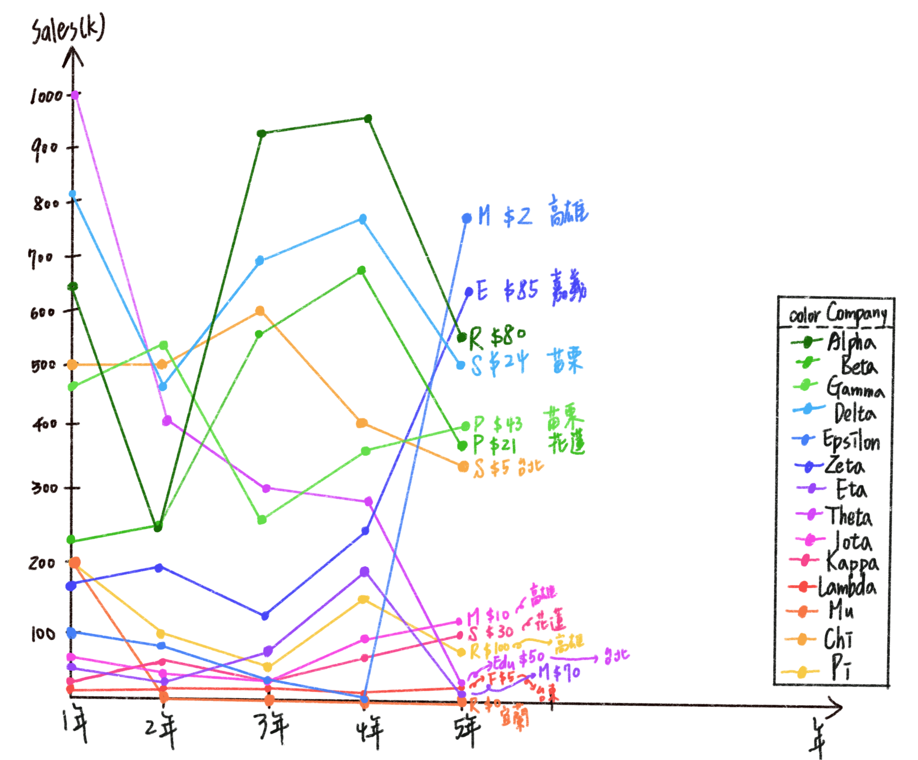
Question 2
Q : Compare the five-year sales and business performance of each company.
Draw:

Slide 7
Question 2
Pros
You can clearly see that Epsilon and Zeta had a significant increase in sales after the fourth year, while Alpha, Delta, and Beta showed very similar sales trends. It is likely that these three companies had similar sales strategies.
Cons
Using too many colors can make it difficult for users to quickly identify information. Perhaps grouping companies by business type with the same color can be considered.

Slide 8
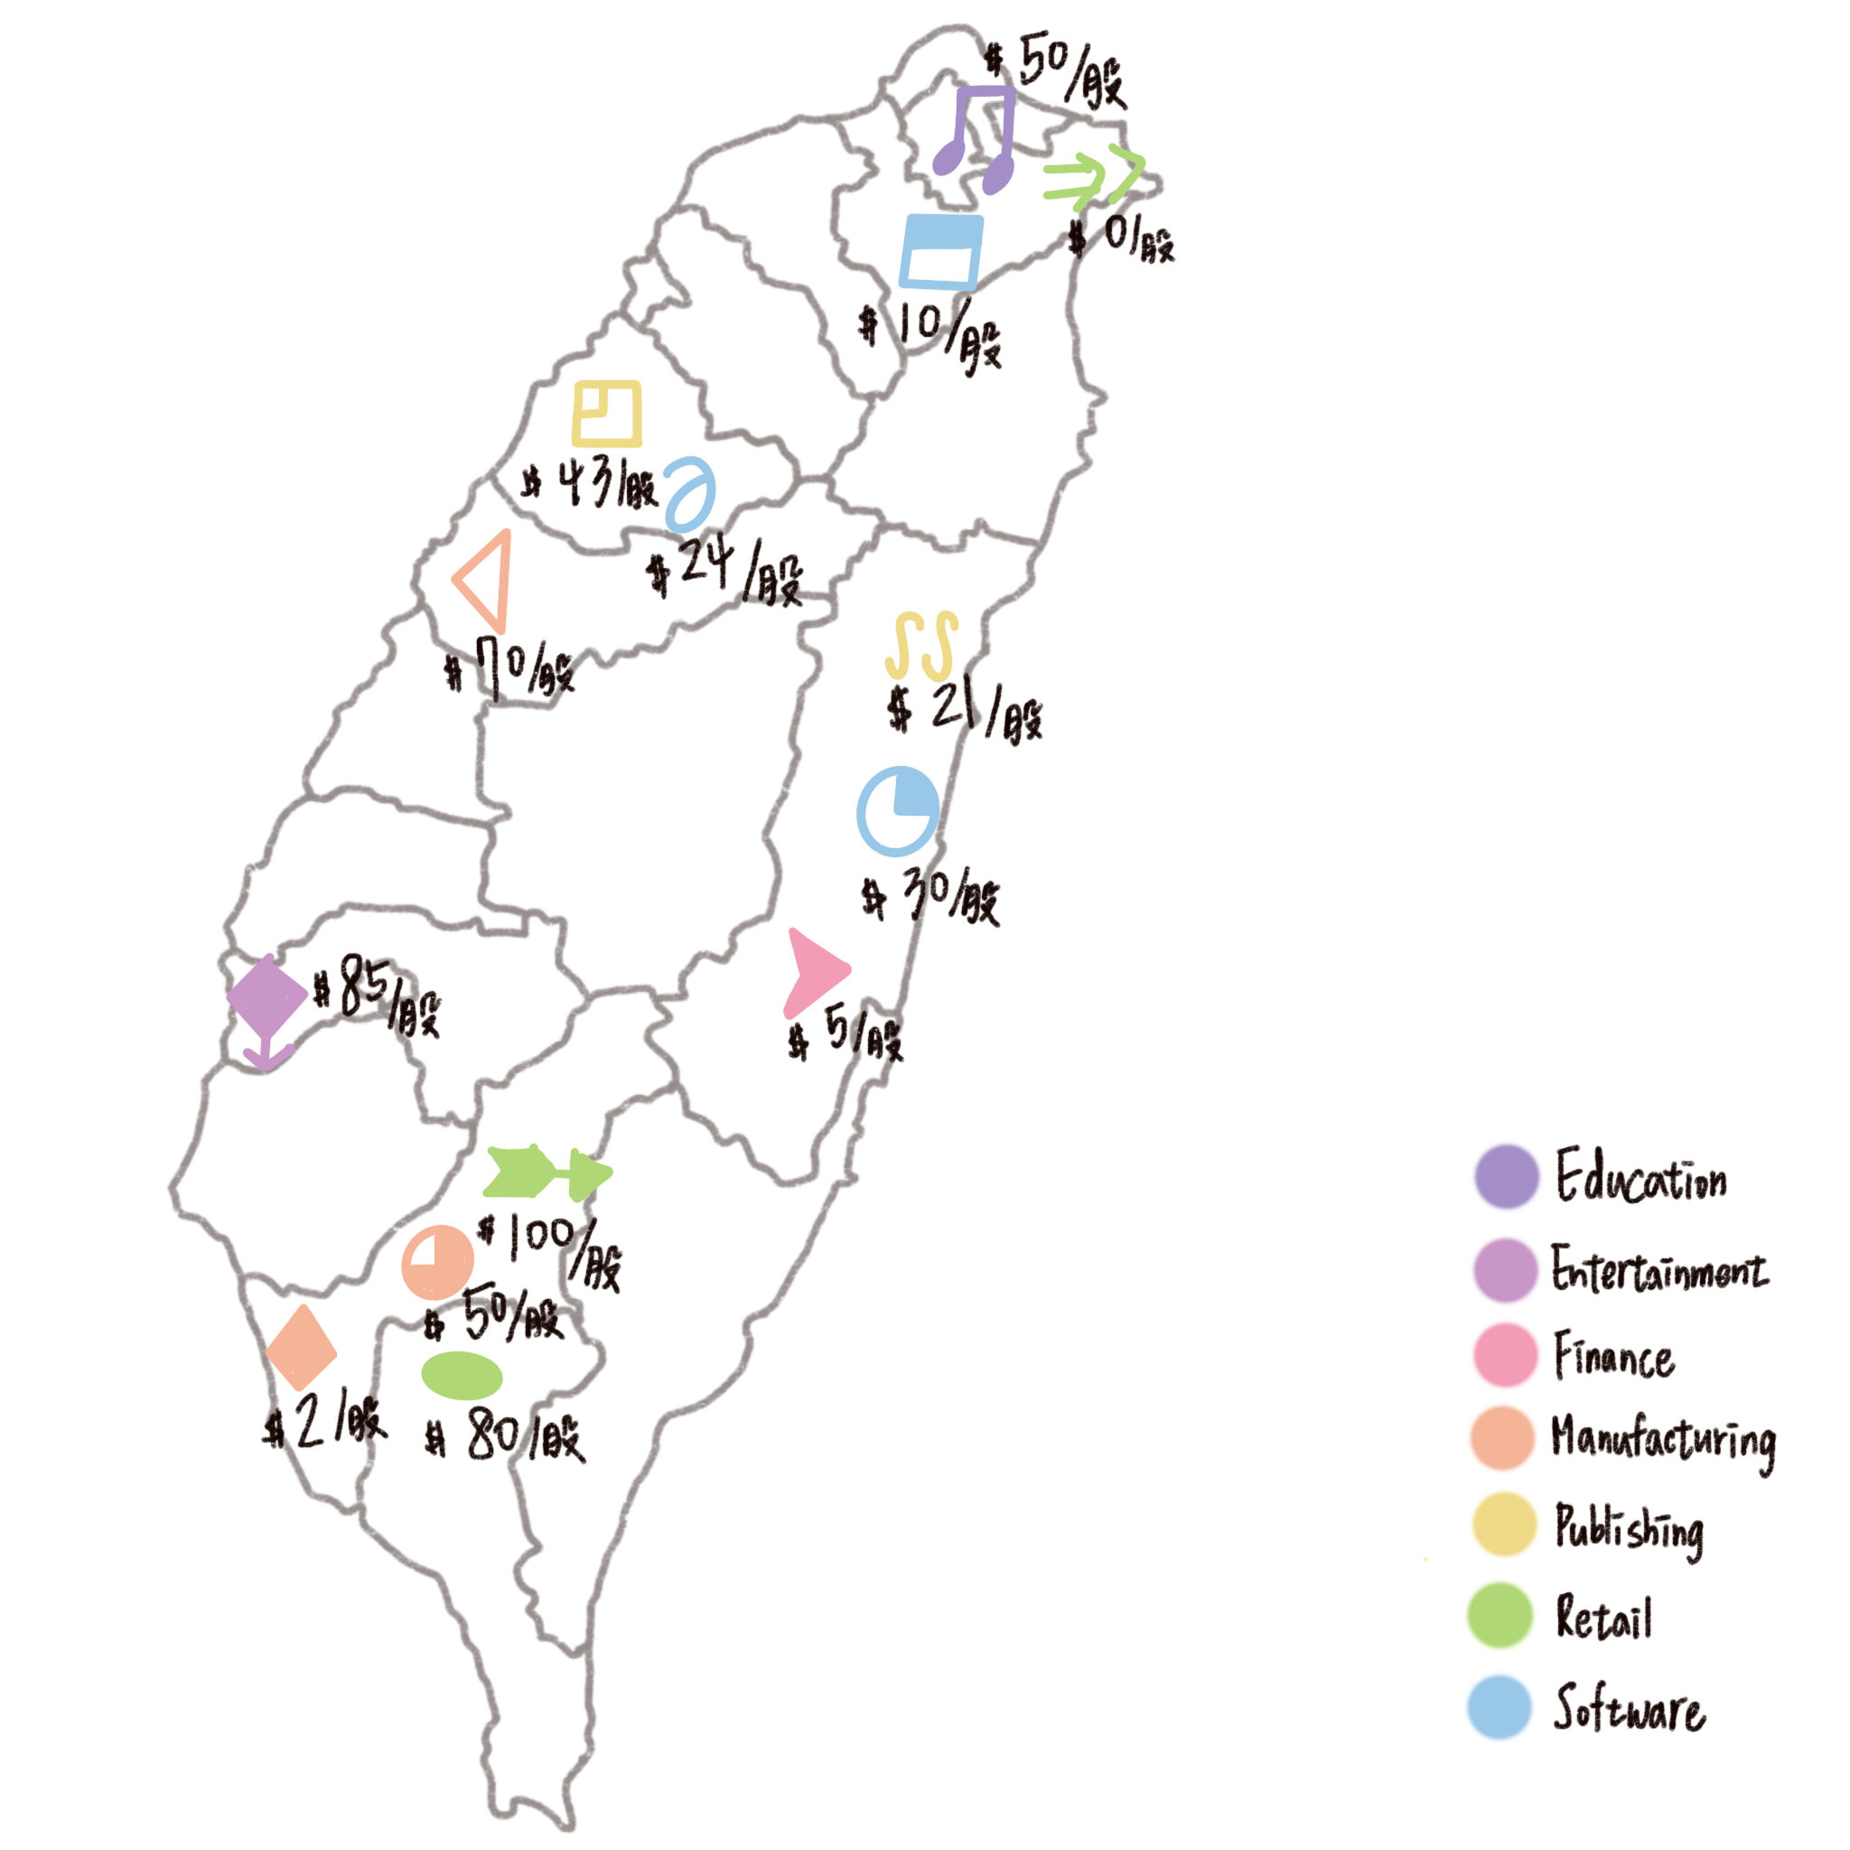
Question 3
Q : Compare the number of companies and the distribution of industries in each city to provide users with a better understanding of the business activities and market conditions in different regions
Draw:

Slide 9
Question 3
Pros
One can quickly observe that there are three companies each in Kaohsiung, Taipei, and Hualien. The majority of companies in Kaohsiung are in the manufacturing industry, while Taipei has an education industry and Hualien has a publishing industry. It is also noticeable that the company with the highest stock price is located in Kaohsiung. When looking at other companies in the retail industry, it appears that retail companies in southern Taiwan have better development.
Cons
It is not possible to know the scale of each company

